Slide 1

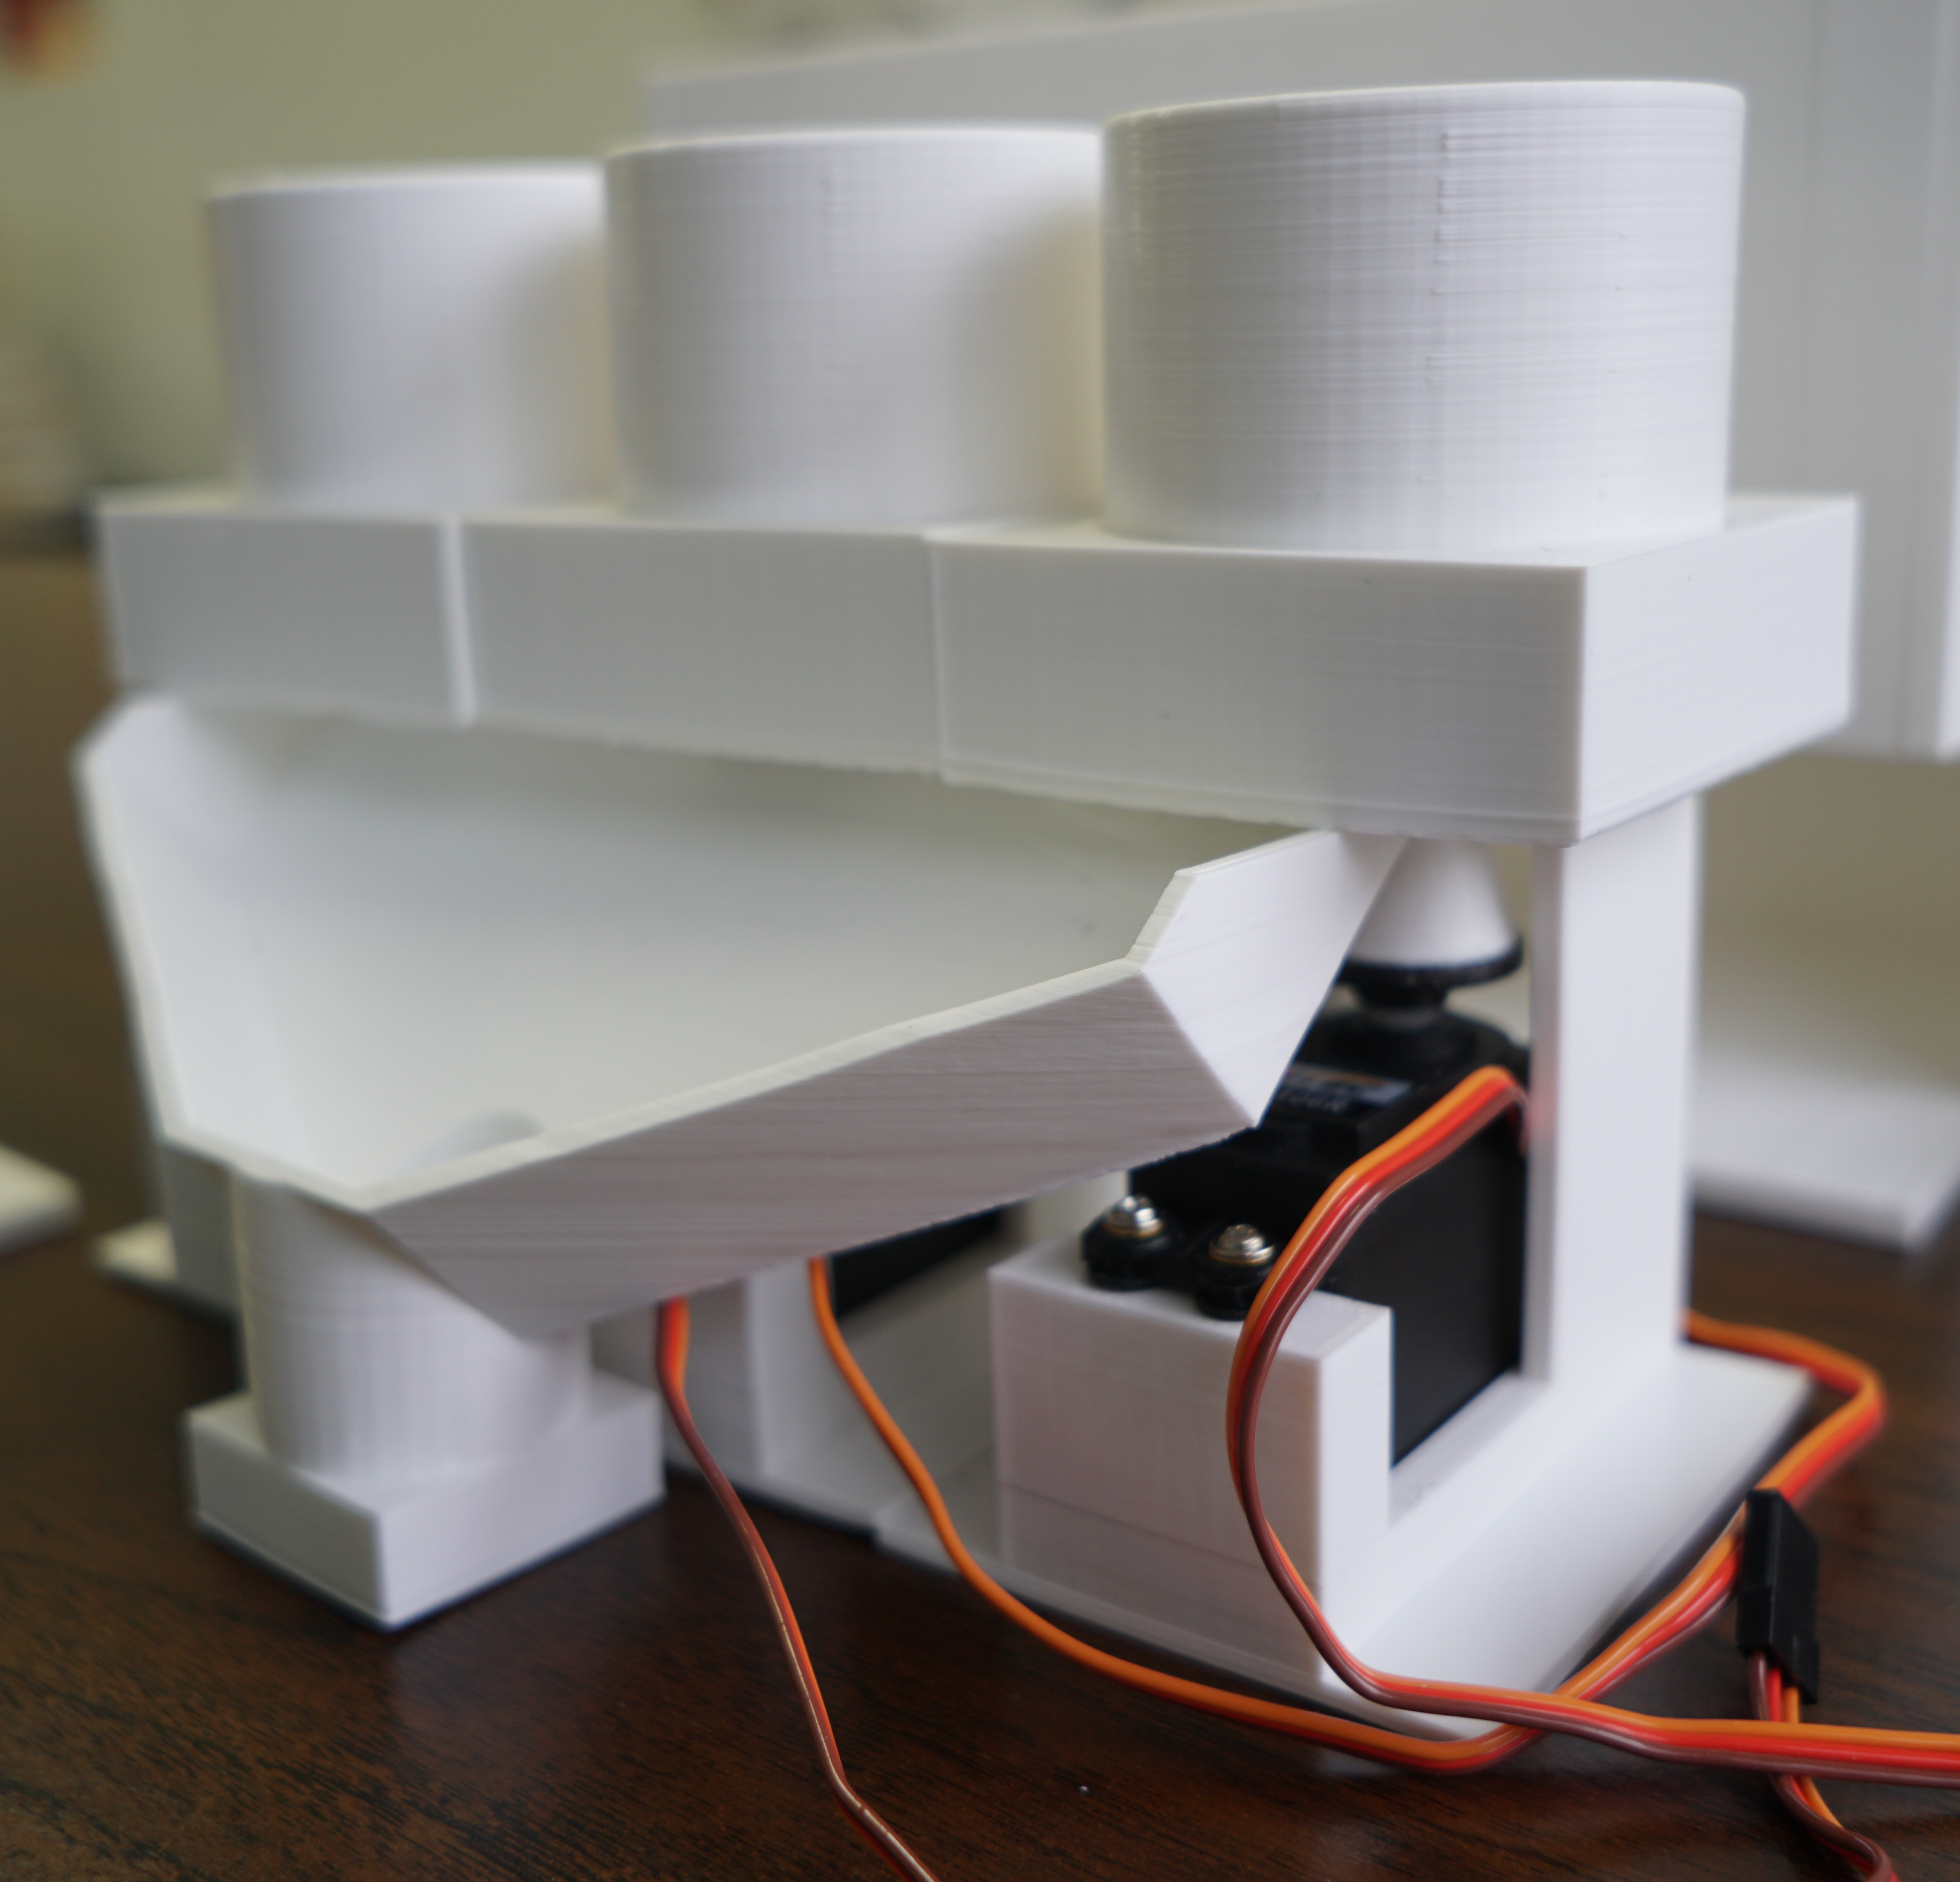
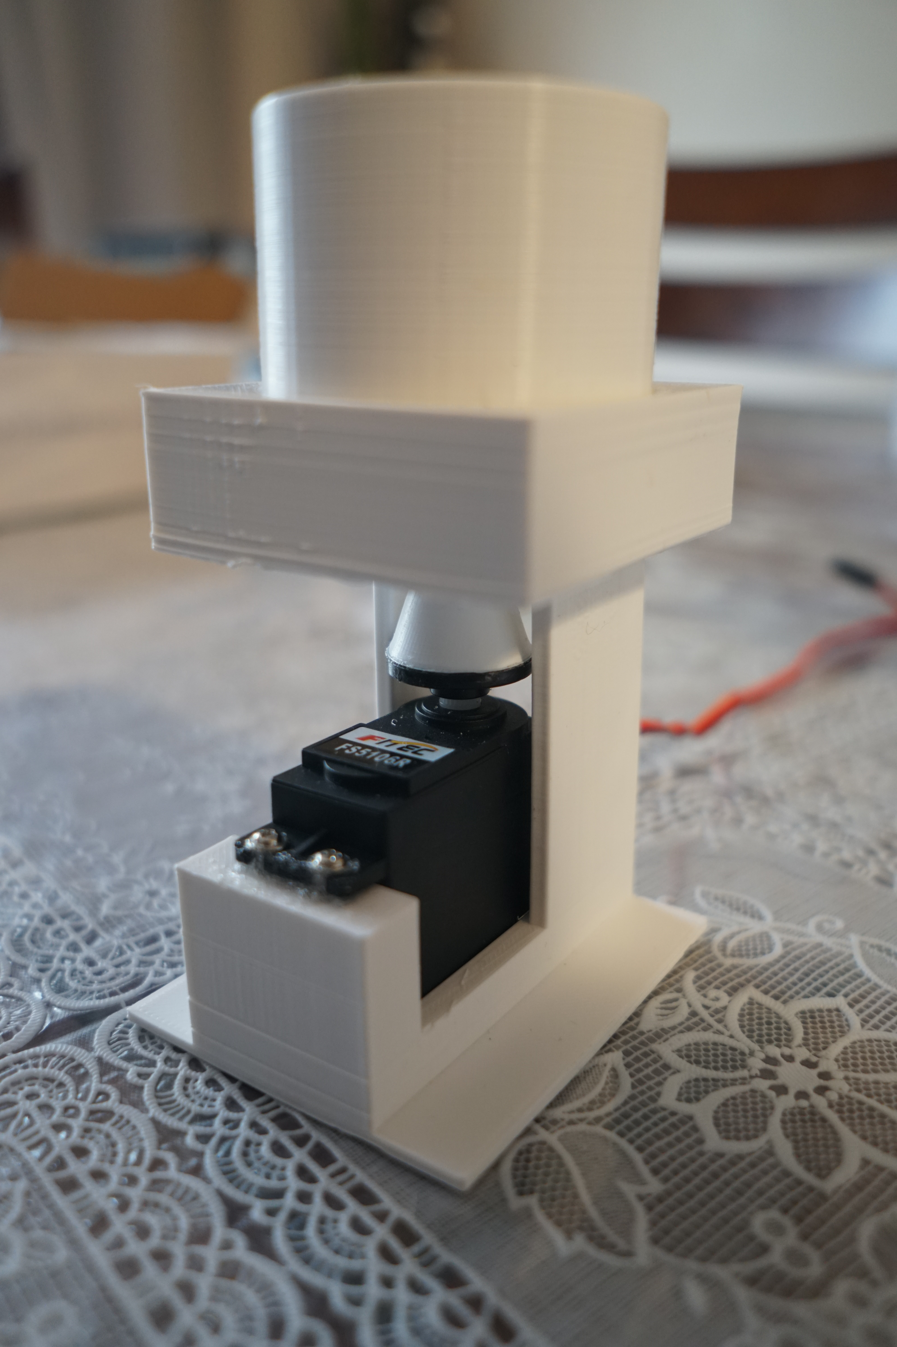
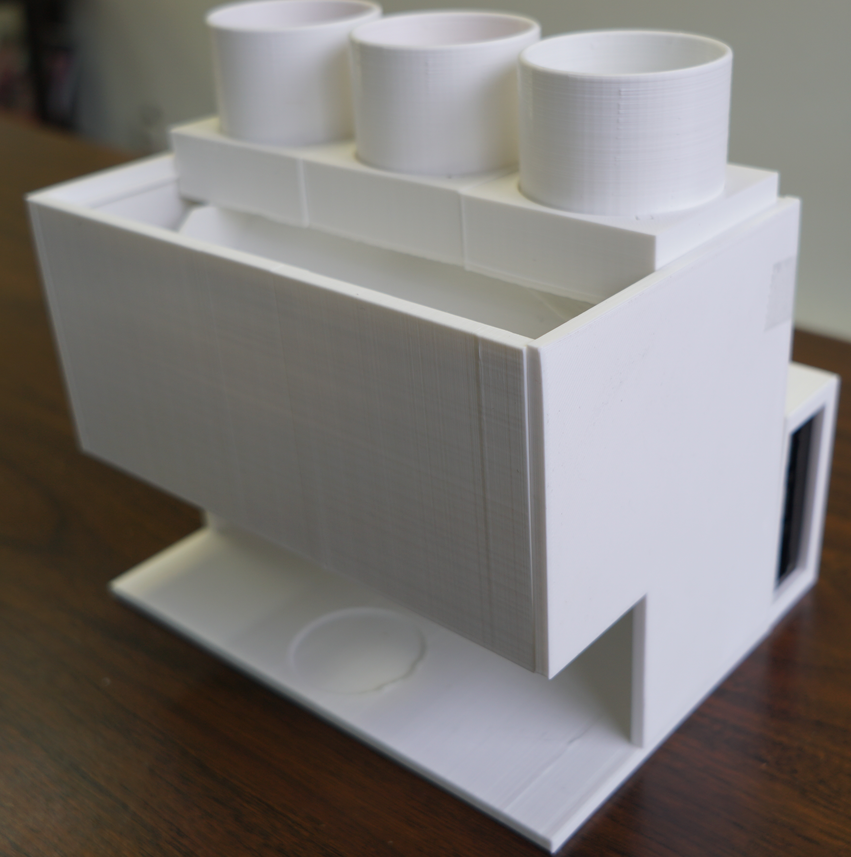

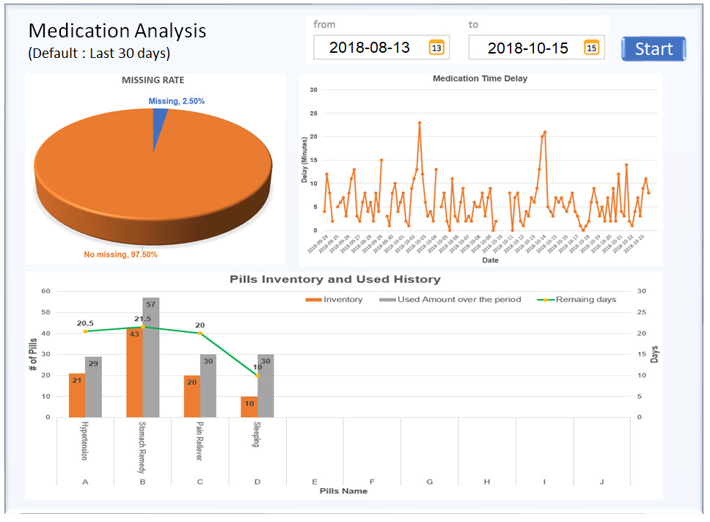
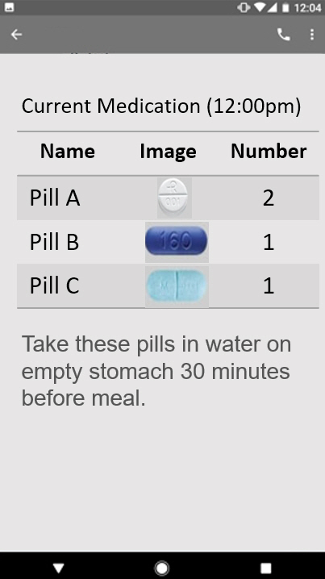
Smart Automatic Pill Dispenser
Davy Ye, Abraham Aziz, Ahmed Zakariya, Jin Hwan Jung, Ahmed Abdirahman Centennial College, Biomedical Engineering Technology
Abstract
Problems/Solutions
Smart Automatic Pill Dispenser
As the aging population in Canada continues to increase rapidly, the consumptions of prescribed medicine are on the rise. Approximately 50% of patients with multiple medications for their chronic illnesses do not take their medications as on time [9]. This poor medication adherence leads to increased morbidity rate and health care cost (Osterberg,2005). This dissertation presents a smart automatic pill dispenser that automatically dispenses medications at a pre-set time. There are currently four automatic pill dispensers in the Canadian market, each of them have many ways in which it can be improved. Examples of current available pacemakers include; The Philips Lifeline pill dispenser and the GMS Med-e-lert pill dispenser . The current technologies used in pill dispensers are limited, current pill dispensers in the market require patients to arrange their pills themselves. This can lead to errors and possible health risks. To mitigate these errors, we have created a disk that only fits for certain types of pills. By doing so, if the caretaker accidentally places the wrong pill in the dispenser, nothing will come out. Also, since our Smart Automatic Pill Dispenser is very user friendly, it will allow anyone to assist the senior while minimizing any human error. To continue onto this product, some future features that will further enhance the dispenser’s use will contain a notification system using a smartphone and easy monitoring from a distance by using a cloud server.
Problems without any devices | Problems with other products in the market* | Improvements in our device
Poor adherence to medication Forgetting medication Delay of medication intake Not taking as prescribed ^{[9]} No inventory (Missing because of shortage) No data of the medication history | Built-in alarms Depending on pre-set pills combination (Human errors) Might be mistaken by other persons No inventory (Missing because of shortage) No data of the medication history * based on the products specification [1-2] | Very user friendly Dispensing pills with security check Notification with instructions via cell phone Pill shortage warning Alarm system that rings every time the machine dispenses
Technical Details
Convenient Use & Pill Storage
Dispensing Mechanism
With the complexity of some automatic medicine dispensers, the Smart Automatic Pill Dispenser was made so that it’s easy to use. Within the dispenser, there are three containers with different types of disks inside. To store the pills, simply place the different type of pills into their respective disk. If another pill is needed instead of a current used one, one can just take out the disk and add a different one that matches the new pill.
In addition, the different types of pills can be kept track of by using the dispensing website. To make managing the dispensing easier for the user, after each time is set for dispensing, the history is saved on the same screen.
The dispensing mechanism is a simple technique that utilizes three motors and different types of disks, Each disk has its own special size that is made according to their pill type. (ex. Round, oval, square, etc.)
The Smart Automatic Pull Dispenser contains two steps to dispense the pill. The first step to dispensing a pill is to input a pill type and quantity through the nurse or user. After the device has entered the data and time to release, the second step is for the motors to actuate and rotate according to the quantity entered.
Introduction
This product helps seniors to consume their medication on time which will promote their wellbeing and reduce the government health care expenditure.
The device is a smart auto pill dispenser that can automatically dispense pill medications at appropriate dose and times. This device will help the increasing population of seniors, which hiked by 6% From the years of 1971 to 2010. According to current projection this number is set to increase rapidly .
This indicates an increase in demand of our product. The market that we will be targeting for this device is the seniors aged 75 to 90, this is consistent with statistics that show 25% of seniors over 65 have been reported to have at least 4 chronic conditions, who likely require multiple daily medications, hence the importance of the pill dispenser. Furthermore, The most important benefits of the automatic pill dispenser are that it promotes patient care and reduces unnecessary hospital visits of patients who forgot to take their medications, this will reduce hospital costs and congestion.
Conclusions
Future Features
We believe this device can be very beneficial to the society in many ways. It can drastically increase life expectancy in seniors due to the fact that they will take their medications on time thus leading to a healthy life. Another outcome we reached is that this device will surely save the government as well as the citizens a lot of time and money. This is through the reduction of unnecessary hospital visits due to missed medications and the waste of time of the staff, that could be useful elsewhere in the hospital. Hospitals get over congested often, this product will surely reduce congestion in hospitals.
Our expectations for this product is that it will be more successful than the similar products on the market solely due to its superior functionality and set up. This product is expected to be used in every health care facility as well homecare and in home use. The ease of use of this product as well as the high accuracy makes it very promising to all medical professionals. Finally, the future for this this device is endless, that have so much potential for upgrades which will better help our loved seniors.
Notification via a smartphone
Monitoring on a Cloud Server
Giving a notification is an essential feature to help seniors to take their medicines on time without any missing.
The traditional way is to use in-built audible or visible alert. However, this method does not guarantee patients’ recognition. Therefore, in order to increase the patients’ recognition, this device uses the smartphone SMS message service. Through that, seniors can get an immediate alert and proper instruction.
This system records all medication information. The stored data can be analyzed and displayed on web-browsers. It gives very useful information such as missing rate, the tendency of delay, and medicine inventory to users and caregivers. The inventory monitoring can also give a notice a certain pre-set time before each medicine runs out.

